Slide 1

On Device Machine Learning
Deep Learning on Mobile Devices
Sravya Yellapragada
Software Engineer
Qualcomm India Private Limited
Twitter : @sravyaysk
Image Source: link

Slide 2
On Device AI
1
Introduction to On Device Machine Learning

Slide 3
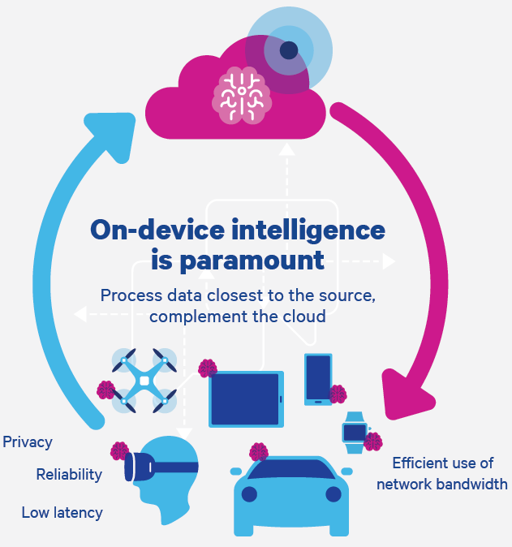
Need for On-Device AI ?
Privacy
Reliability
Latency
Cost
Light Weight
Picture source : link

Slide 4
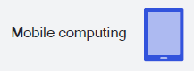
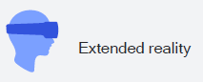


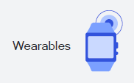

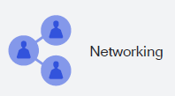
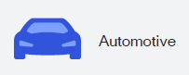

Mobile scale changes everything
Source : link

Slide 5
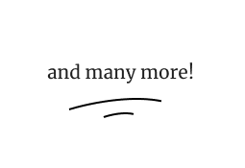
Some cool AI applications on device
Hypervisor – App specific Isolated OS
Authentic photo Identifier
Auto focus
Auto exposure
Advanced auto white balance
Dark light photography
Screen wake
Lift detection
Activity recognition
Earthquake detection
Car crash detection
Face ID
Audio event detection
Face swap, snapchat photo filters
3D Vision
3D Face Reconstruction and Facial Animation
3D Reconstruction
3D Avatar
AI Image Enhancement
Core Image Quality
AR Inception
Biometric Security
Skin condition detection

Slide 6
On Device AI
a
Introduction to On Device Machine Learning
2
Hardware accelerators and Mobile SoC’s

Slide 7
Mobile SoC
SoC Chip
Multimedia Encoders /Decoders
Memory
CPU (Central Processing Unit)
Supports FP32, INT8
DSP (Digital Signal Processor)
Quantized inference
Supports INT8
TPU (Tensor Processing Unit)
Supports INT8
GPU (Graphical Processing Unit)
Floating point Inference
Supports FP16, FP32
DMA
CPU
GPU
DSP
Audio
USB
Video
NIC
Example of an SoC block diagram

Slide 8





Accelerates Performance
Create
Experiment
Hardware Acceleration unlocks performance gains
Using GPU can be 10 times faster than using CPU alone
Performance, stability, accuracy can vary by device configuration
Automatic acceleration – provide your criteria for runtime on specific workloads
High quality data + Hardware + Efficient mobile inference engine + Efficient model = Good DL App
Run Experiment
Get Results
Analyze
Data
Deploy allowlist

Slide 9
On Device AI
a
Introduction to On Device Machine Learning
a
Hardware accelerators and Mobile SoC’s
3
End-to-End ML workflow

Slide 10
End-to-End ML workflow
PROBLEM DEFINITION
DATA ACQUISITION AND DATA PREPARATION
Data Acquisition | Data Visualization and Exploration | Data Preparation and Transformation | Data Versioning | Data Pipelines | Data Labelling
MODEL DEVELOPMENT AND TRAINING
Feature Extraction and Engineering | Feature Store | Network Architecture | Model Training | Model Debugging | Model Repository
Bias detection and Mitigation | Tuning and Optimization | Experiment management | Distributed Model Training | Model Explainability | Model MarketPlace
ML Pipelines and workflows | Model Logging | Development Environment Support | Deep learning support | Reinforcement learning support | Auto ML
MODEL DEPLOYMENT AND OPERATIONS
Model Portability and compression | Model Monitoring | Model Deployment | Edge ML support | Cost Management | Model Versioning
SYSTEM WIDE FEATURES
Model Infrastructure Orchestration | Accelerator Support | Kubernetes Support | Security | Governance | Collaboration
- On Device Supported
- Off Device activities

Slide 11
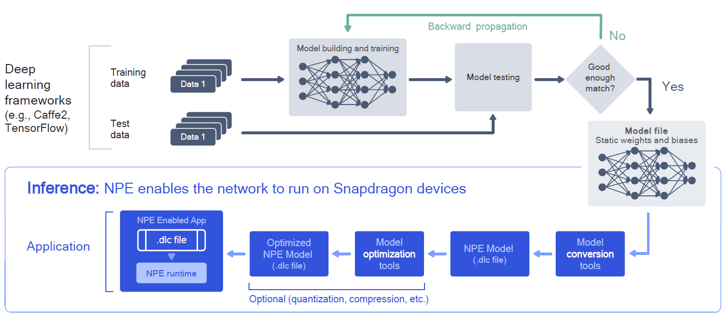
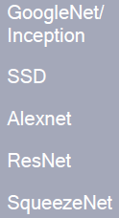
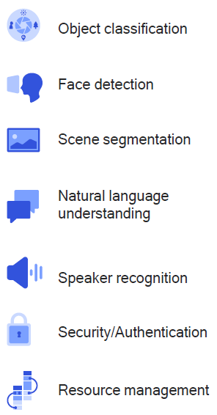

Training and Inference Workflow
®
Source : link

Slide 12
On Device AI
a
Introduction to On Device Machine Learning
a
Hardware accelerators and Mobile SoC’s
a
End-to-End ML workflow
4
Qualcomm® Neural Processing SDK

Slide 13
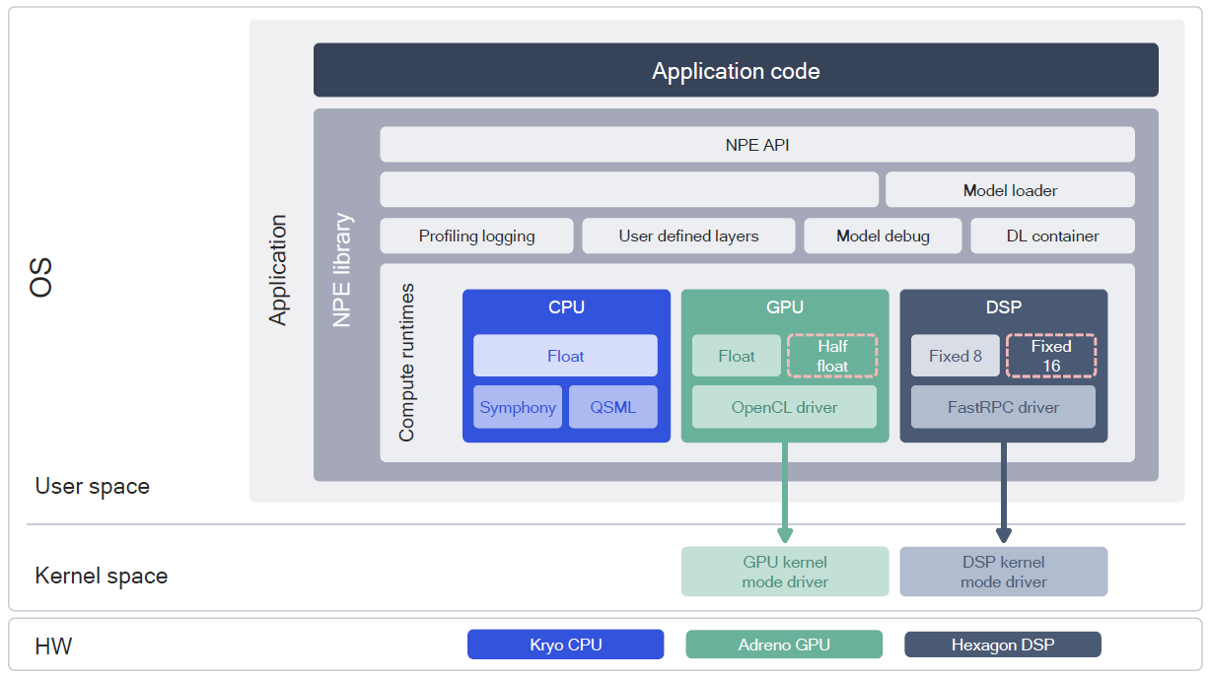
SW Architecture of Qualcomm Neural Processing SDK
OS Support : ARM Android, ARM Linux, x86 Linux
Source : link

Slide 14
Running Tensorflow InceptionV3 model on Android
SETUP THE SDK
Download Qualcomm Neural Processing Engine SDK https://developer.qualcomm.com/software/qualcomm-neural-processing-sdk/tools and unzip it to SNPE_ROOT
MODEL CONVERSION
Convert your tensorflow model to NPE model
PERFORM INFERENCE
Run the NPE model on Android with selected hardware accelerator
Set Environment paths
Install missing packages by running dependency scripts
Download Android NDK, Tensorflow
OBTAIN AND MAP RESULTS
Map our resulting confidence values to labels

Slide 15
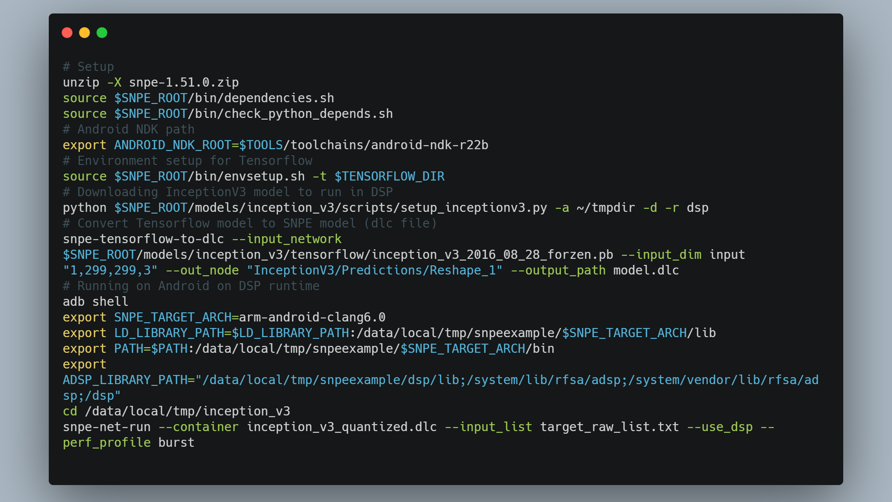
https://developer.qualcomm.com/sites/default/files/docs/snpe/

Slide 16
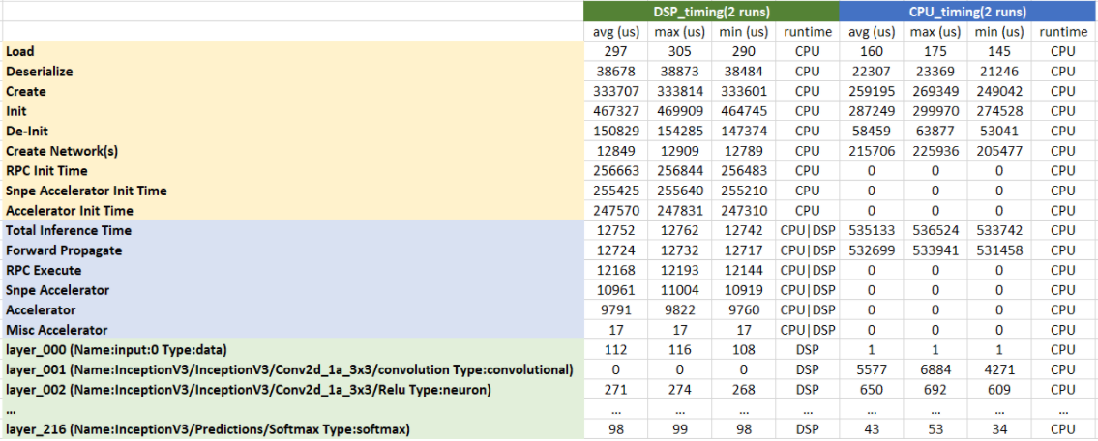
Metrics Summary
Device Metrics
Source : link

Slide 17
On Device AI
a
Introduction to On Device Machine Learning
a
Hardware accelerators and Mobile SoC’s
a
End-to-End ML workflow
a
Qualcomm® Neural Processing SDK
5
Android NNAPI

Slide 18
Android NNAPI
Application
Machine learning framework
Android NN API
The Android Neural Networks API (NNAPI) is an Android C API designed for running computationally intensive operations for machine learning on Android devices
Neural Networks API programming model has four main abstractions
Model – computational DAG of Ops
Compilation – compiling NNAPI model to low level code
Memory - shared memory, memory mapped files, memory buffers
Execution - applying an NNAPI model to a set of inputs and to gather the results and measure performance
Android Neural Networks Runtime
Hardware Accelerators
Android NN HAL
Vendor NN Driver
GPU | DSP | Specialized Processor | CPU Fallback
High level Architecture for NN API

Slide 19
NN API Workflow
Tensorflow Lite Model (Flat buffer file)
Subgraph 0
Original Model
Client
Tensorflow
Tensorflow
Lite model
Subgraph 1
Call subgraph 0 with golden inputs
Call subgraph 2 with outputs from original model + golden outputs
Module shipped in vendor partition
Compilation
ANN offline tool
(to make NNAPI/NNHAL calls)
NNAPI/NNHAL model
Offline Workflow
Subgraph 2
Calculate architecture specific metrics over subgraph 0 outputs and golden outputs. Determine ok or not
GetSupportedOperations()
Online Workflow
prepareModel()
Buffers
Weights for original model
Golden inputs (eg: jpeg images)
Golden outputs (eg: class probabilities)
Execute()

Slide 20
Popular Mobile Deep Learning Solutions
TensorFlow Lite
PyTorch Mobile
Caffe2
Qualcomm Neural Processing Engine SDK
Core ML
Google ML Kit
Mobile AI Compute Engine (MACE)
Paddle Lite
Source : link

Slide 21
Some Tools to visualize Network Architecture
Input
Convolution
MaxPooling
BatchNormalization
Convolution
Convolution
Tensorboard
Net2Vis
VisualKeras
Draw_Convnet
NNSVG
Plot NeuralNet
Caffe
Matlab
Keras.js
Netron
Netscope CNN analyser
Texample
DotNet
GraphViz
Keras Visualization
Conx
Keras sequential ascii
EENUI
NNet
Graphcore
Neataptic
Tensor space
Monial
Quiver
Concat
AvgPooling
Dense
Softmax
Output
Example Computational Graph

Slide 22
On Device AI
a
Introduction to On Device Machine Learning
a
Hardware accelerators and Mobile SoC’s
a
End-to-End ML workflow
a
Qualcomm® Neural Processing SDK
a
Android NNAPI
6
State of the art applications

Slide 23
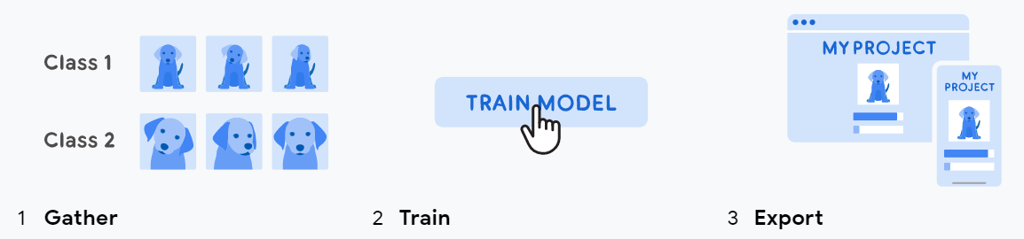
Model Fine Tuning
Transfer Learning
Prepare the dataset
Find pre-trained model
Fine tune it as per your usecase
Export, Convert & Deploy
State-of-the-art Models
State-of-the-art Resources:
https://www.customvision.ai
https://teachablemachine.withgoogle.com
https://modelzoo.co
https://paperswithcode.com/sota

Slide 24


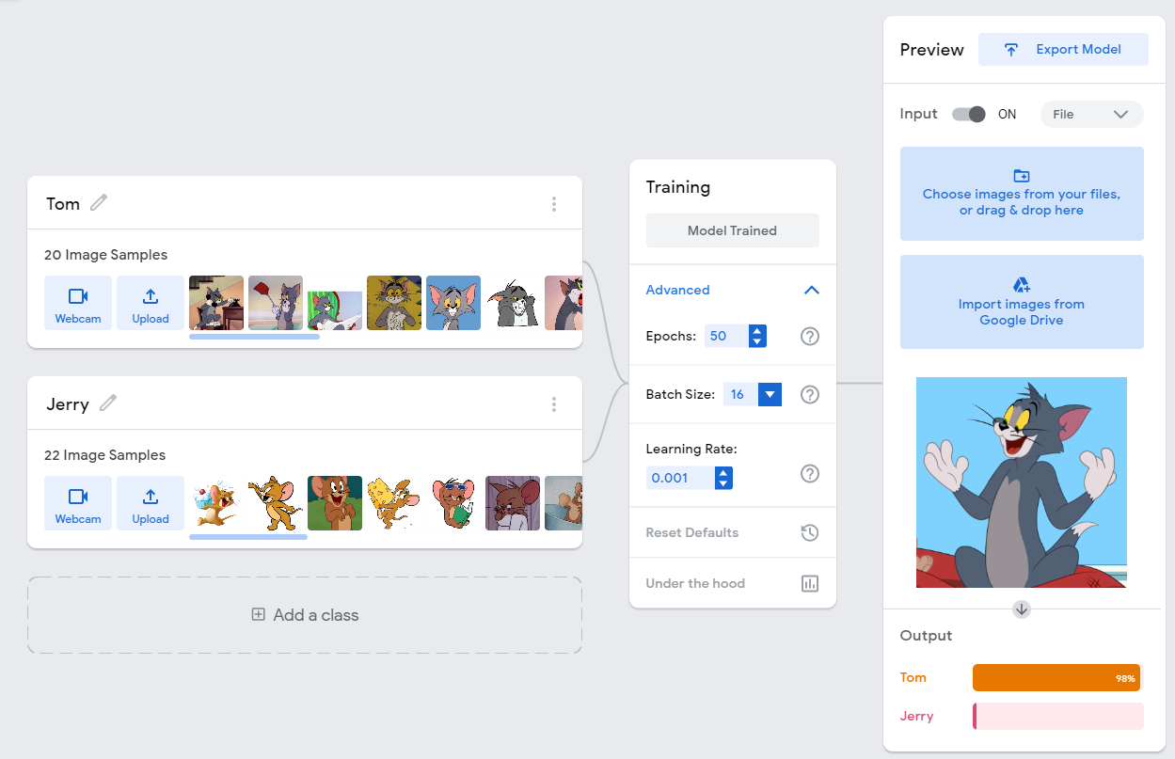
Cartoon Classification App
Fine tuning : https://teachablemachine.withgoogle.com/
Demo code : https://github.qualcomm.com/syellapr/TeachableMachineImageClassification

Slide 25
On Device AI
a
Introduction to On Device Machine Learning
a
Hardware accelerators and Mobile SoC’s
a
End-to-End ML workflow
a
Qualcomm® Neural Processing SDK
a
Android NNAPI
a
State of the art applications
7
Benchmarking Performance Metrics

Slide 26
Hardware Impact on Performance
Accuracy
Difficulty of dataset/task to be considered. Requires more complex DNN models
Throughput
Runtime for running specific DNN models
Latency
Batch size used in evaluation
Energy and power
Power consumption for running DNN models (DRAM for off chip memory access)
Hardware cost
On chip storage
Flexibility
Performance across range of DNN models and tasks
Scalability
Scaling of performance with amount of resources

Slide 27
AI Benchmark V4
Test | Model | Inference modes
Image Classification | Mobilenet v2 | INT8 + FP16
Object Recognition | Inception v3 | INT8 + FP16
Face Recognition | Mobilenet v3 | INT8 + FP16
Object Recognition / Classification | Mobilenet v2 parallel | INT8 + FP16
Optical character Recognition | CRNN/Bi - LSTM | FP16 + FP32
Image Deblurring | Pynet | INT8 + FP16
Image super resolution | VGG 19 | INT8 + FP16
Image super resolution | SRGAN | INT8 + FP16
Bokeh Simulation | U-Net | INT8 + FP16
Semantic Segmentation | Deeplab v3+ | INT8 + FP16
Photo Enhancement | DPED-Resnet | INT8 + FP16
Text Completion | Static RNN / LSTM | FP16
Memory Limits | SRCNN 9-5-5 | FP16
Processor |  | Snapdragon 888 | HiSilicon Kirin 9000 | Exynos 2100
AI Accelerator |  | DSP (Hex. 780) + GPU (Adreno 660) | NPU (3 Cores, Da Vinci series) | NPU + GPU (Mali-G78 MP14)
CPU-Q | Score | 5401 | 4346 | 4839
CPU-F | Score | 9891 | 8584 | 9632
INT8 | NNAPI 1.2 | 54216 | 14280 | 27394
INT8 | Accuracy | 92.1 | 62.4 | 93
FP16 | NNAPI 1.2 | 28718 | 73781 | 37336
FP16 | Accuracy | 61.8 | 81.9 | 86.4
INT8 | Parallel | 5032 | 1814 | 2237
FP16 | Parallel | 2107 | 4204 | 2780
LSTM |  | 808 | 461 | 7324
AI Score (x1000) |  | 156.5 | 148.0 | 133.2
Performance Ranking of Mobile SoC
AI Tests used in AI Benchmark
https://ai-benchmark.com/download.html

Slide 28

Battery utilization and Thermal Throttling
Battery Life
PCMark 10 application runs scenarios that tests battery life for Microsoft applications, web browsing, video conferencing, writing, gaming, idle time
Runtime, FPS α (1/Battery life)
Adaptive Battery, Adaptive Brightness by DeepMind
Thermal HAL
Factors : Algorithm Complexity, Form factor size, System frequencies
Set critical temperature threshold and gets mitigation status codes if temp exceeds it
IThermalEventListener sends status codes LIGHT, MODERATE, CRITICAL, SHUTDOWN

Slide 29
On Device AI
a
Introduction to On Device Machine Learning
a
Hardware accelerators and Mobile SoC’s
a
End-to-End ML workflow
a
Qualcomm® Neural Processing SDK
a
Android NNAPI
a
State of the art applications
a
Benchmarking Performance Metrics
8
Optimization techniques

Slide 30
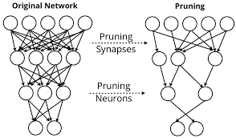
Model Optimization Techniques
Pruning
Decreases model size, storage space; Increases execution speed, energy and performance efficient
Remove least important neurons
Remove connections with weight below threshold
Dynamic pruning results in higher accuracy maintaining network capacity
Quantization
Approximating a neural network that uses floating-point numbers by a neural network of low bit width numbers
Reduces the memory requirement, computational cost and gain in speed with less impact on accuracy
Replace the weights and biases with scaled int8 integers in each layer
NetAdapt technique automatically adapts a pretrained network to a mobile platform given a resource budget
32 bit
4 bit

Slide 31
Other popular Model Optimization techniques
Quantization
Weight Sharing
Low-Rank Approximation
Binary / Ternary Net
Winograd Transformation
Huffman Coding
Graph partitioning
Network optimization
Network binarization and XNOR-Networks

Slide 32
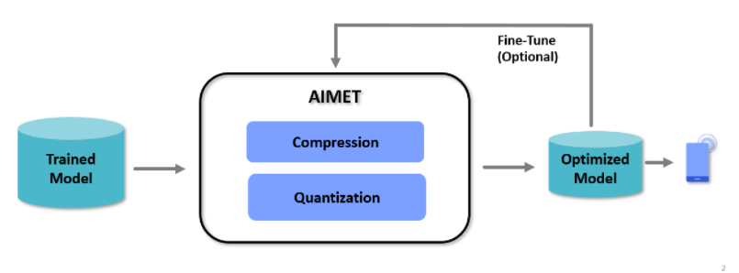
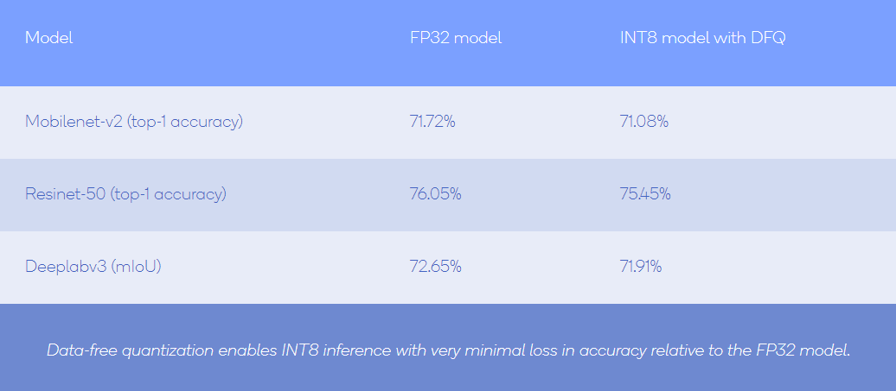
AI Model Efficiency Toolkit (AIMET)
Compression
Quantization Simulation
Cross-Layer Equalization
Quantization
Spatial SVD
Adaptive Rounding
Bias Correction
Channel Pruning
Weight SVD
Visualize weight ranges
Visualization
Visualize per-layer sensitivity to compression
https://quic.github.io/aimet-pages/index.html

Slide 33
TVM – End-to-End Optimization framework
TVM is a Python-based compiler for optimizing deep learning models to run efficiently on the Hexagon DSP
Graph and tensor operator optimizations
Run computations efficiently on any hardware backend
Automatically generates and optimizes tensor operators on backends
Third party Frameworks
Computational Graph
Optimization
Tensor Compute Description
Schedule space and Optimizations
Backends
https://tvm.apache.org/

Slide 34
Auto ML Mobile
Technique to design efficient network architecture
Neural Architecture Search (NAS) is an automated approach for designing models using reinforcement learning
While NAS also aware of hardware, it minimizes run-time on device and maximizes accuracy
Incorporates latency information into the reward objective function
Measure real-world inference latency by executing on a particular platform
Facebook FBNet and Google MnasNet are some state-of-the-art NAS approaches
Controller
Search models in search space
deploy
Target device
Reward/
Penalize
Reinforcement learning model
Latency
Accuracy
Workflow for Neural Architecture Search models

Slide 35
On Device AI
a
Introduction to On Device Machine Learning
a
Hardware accelerators and Mobile SoC’s
a
End-to-End ML workflow
a
Qualcomm® Neural Processing SDK
a
Android NNAPI
a
State of the art applications
a
Benchmarking Performance Metrics
a
Optimization techniques
9
Conclusion

Slide 36
Challenges and Future Scope
On Device Training
Better Tooling support – Tracking performance, Understanding graph compatibility with hardware accelerators
Building ML Apps easier – drag and drop ML models in Android Studio to generate ML inferences, profiling and performance metrics
ML models version control using MLMD by Tensorflow Extended
More state-of-the-art (SOTA) models
Applying quantization-aware training eg: TensorFlow Model Garden
Better Hardware accelerator and Model Optimizations
Increasing ops coverage based on user feedback
Battery life, Thermal mitigation, Memory

Slide 37

References
https://twimlai.com/solutions/introducing-twiml-ml-ai-solutions-guide/
https://www.engineersgarage.com/what-is-an-soc/
https://developer.qualcomm.com/docs/snpe/index.html
https://developer.android.com/ndk/guides/neuralnetworks
https://analyticsindiamag.com/8-platforms-you-can-use-to-build-mobile-deep-learning-solutions/
https://github.com/ashishpatel26/Tools-to-Design-or-Visualize-Architecture-of-Neural-Network
https://www.practicaldeeplearning.ai
https://ai-benchmark.com/ranking.html
https://benchmarks.ul.com/news/pcmark-10-introduces-a-better-way-to-test-battery-life
https://deepmind.com/blog/announcements/deepmind-meet-android
https://source.android.com/devices/architecture/hidl/thermal-mitigation
https://quic.github.io/aimet-pages/index.html
https://tvm.apache.org/docs
https://towardsdatascience.com/ml-infrastructure-tools-for-model-building-464770ac4fec
https://arxiv.org/pdf/1812.03443.pdf
https://www.rle.mit.edu/eems/publications/tutorials/
https://www.tensorflow.org/lite/guide

Slide 38

Twitter: @sravyaysk

Slide 39
On Device Machine Learning
Deep learning on Mobile devices
Sravya Yellapragada
Software Engineer
Qualcomm India Private Limited

Slide 40
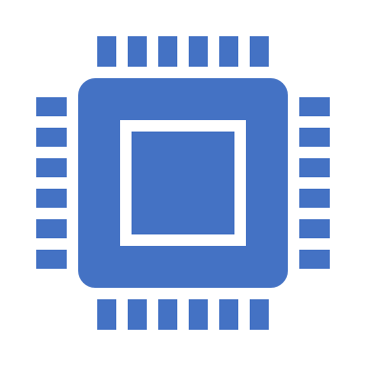
Table of Contents
Introduction to On Device Machine Learning
Hardware accelerators and Mobile SoC’s
End-to-End ML workflow
Qualcomm® Neural Processing SDK
Demo on running deep learning model on Android
Android NNAPI
State of the art applications
Benchmarking Performance Metrics
Optimization techniques
Auto ML Mobile
Mobile AI Applications
Challenges and Future scope

Slide 41
Running TF InceptionV3 model on Android
SETUP
On Ubuntu 18.04, Download Qualcomm Neural Processing SDK link and Tensorflow link and Android NDK link
Unzip Qualcomm Neural Processing SDK and set SNPE_ROOT as extracted dir
Run dependency scripts to install missing packages
Building the Native C++ Example on Android requires the Android NDK installed
Environment setup for Tensorflow
Source : link

Slide 42
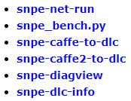
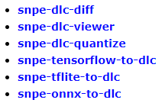
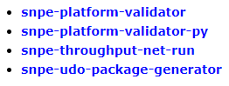
Running TF InceptionV3 model on Android
MODEL CONVERSION
Command to download and setup Inception v3 model to run in DSP
Convert tensorflow model to NPE model (.dlc)
RUNNING ON ANDROID USING DSP RUNTIME
OTHER TOOLS IN SDK
Source : link

Slide 43
Hardware Impact on Performance

Slide 44
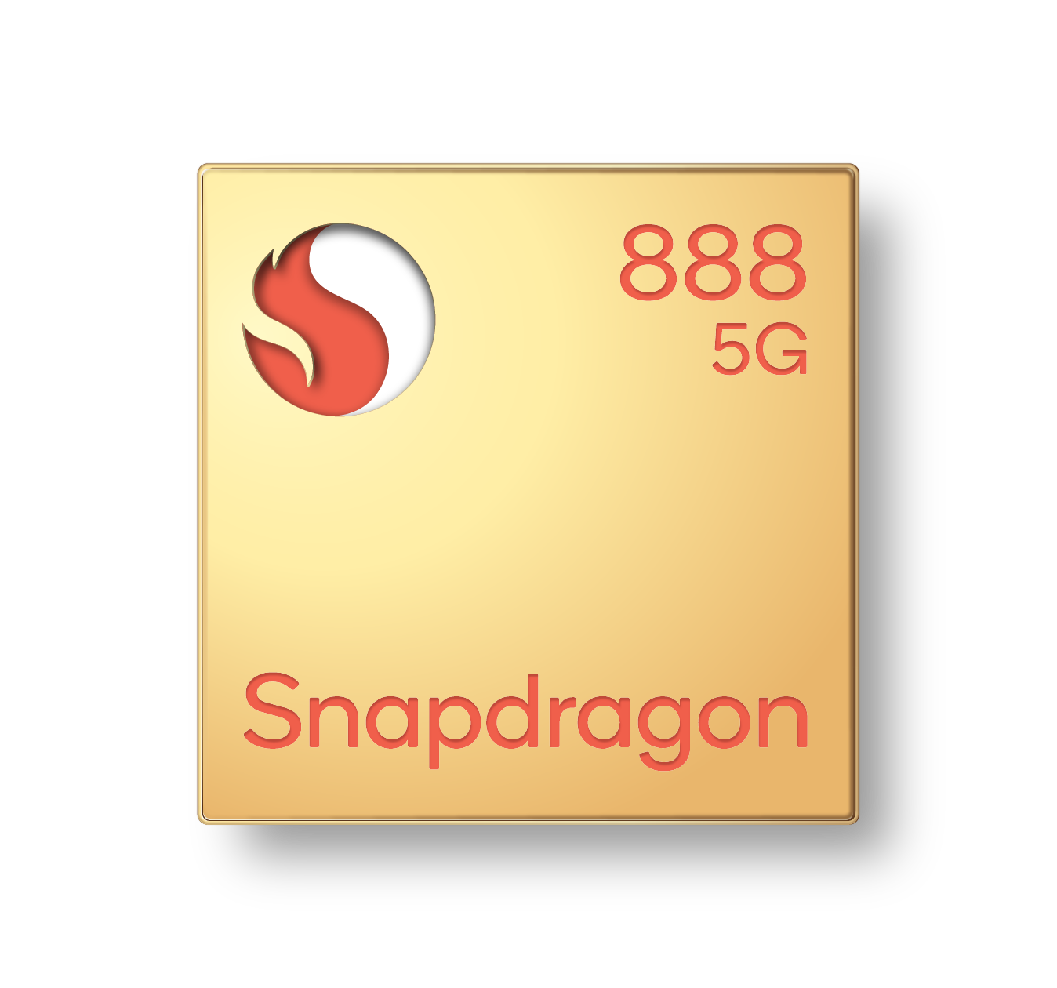
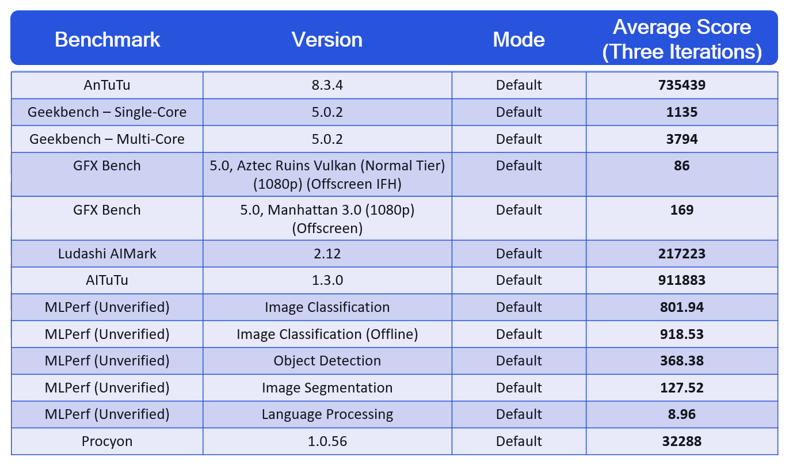
Snapdragon® 888 Mobile Platform Benchmark Results
Source : link

Slide 45
Battery utilization and Thermal Throttling
Battery Life
PCMark 10 application is used to benchmark battery life
It runs scenarios that tests battery life for Microsoft applications, web browsing, video conferencing, writing, gaming, idle time etc
Runtime, FPS are indirectly proportional to Battery life
Adaptive Battery, Adaptive Brightness by DeepMind
Thermal HAL
Algorithm Complexity
Form factor size
System frequencies
Set critical temperature threshold and gets mitigation status codes if temp exceeds it
IThermalEventListener sends status codes LIGHT, MODERATE, CRITICAL, SHUTDOWN

Slide 46

Model Optimization

Slide 47
Pruning - Quantization
Pruning decreases model size, storage space, increases execution speed, energy and performance efficient
Remove least important neurons
Remove connections with weight below threshold
Dynamic pruning results in higher accuracy maintaining network capacity
Energy aware pruning
Quantization is the process of approximating a neural network that uses floating-point numbers by a neural network of low bit width numbers
Reduces the memory requirement, computational cost and gain in speed with less impact on accuracy
Replace the weights and biases with scaled int8 integers in each layer
NetAdapt – platform aware DNN adaptation

